Slide 1

Big Mountain Resort
Competitive Analysis

Slide 2
Problem Identification
Current Situation
New chair lift this season
$1.54M add’l operating costs
How Can We:
Offset added costs
Maintain profit margin

Slide 3
Recommendation & Key Findings
Recommendation:
Raise ticket prices by 5-6%
Key Finding
Big Mountain underpriced relative to key selling features
Summit Elevation
Vertical Drop
Longest Run
Total Lifts

Slide 4
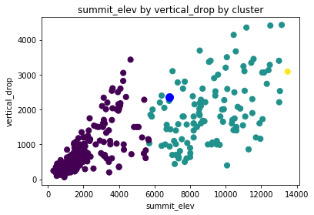
Results & Analysis – Summit & Vertical Drop
Two Key Pricing Factors:
Summit Elevation
Vertical Drop
Both competitive advantages for Big Mountain

Slide 5
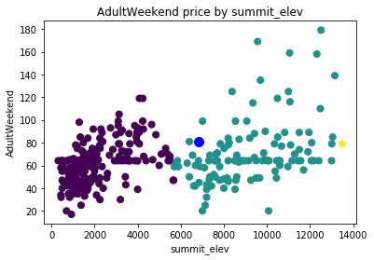
Results & Analysis – Summit & Pricing
Underpriced relative to comparably elevated parks
Vertical Drop: similar trend

Slide 6
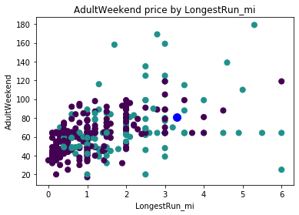
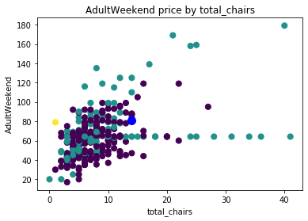
Results & Analysis – Other Factors
Underpriced trend appears in other pricing factors
Examples: Longest ski run & Total number of chairs/lifts

Slide 7
Summary
Underpriced based on relative value of Big Mountain’s features
Recommend increasing ticket prices accordingly
Expected Pricing (based on model):
$85/weekend ticket
Current Price:
$81

